Slide 1

Blood Bank System
Presenting by
Aparna Marepally
Chandra Venkata Vijaya Gopal Raju Kalidindi
Manoj Vamanaguntla
Pooja Sri Ramineni
Praveen Babu Narni
Sandhya Paladugu

Slide 2

Outline
Introduction
Problem Statement
Use Cases
Functional Requirements
Non-Functional Requirements
Architecture diagram
Data management plans
Prototype demos
Accomplishments
Sprig 2024 Plan

Slide 3
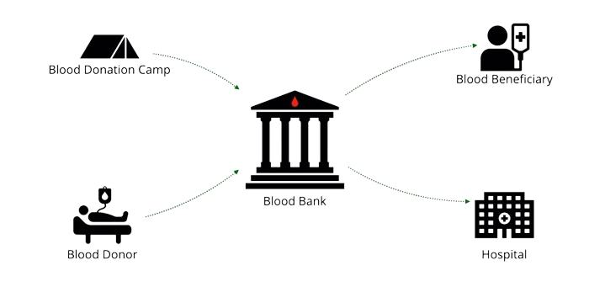
Introduction
Regardless of technological advancements, the majority of blood bank systems still operate manually today. As a result, there is a general issue with the supply of necessary blood types.

Slide 4
PROBLEM STATEMENT
Many blood banks still rely on manual processes and outdated record-keeping systems, leading to inefficiencies, errors, and delays in providing life-saving blood products.
To address these challenges, there is a pressing need for a modern, user-friendly, and secure web application for managing blood bank operations.

Slide 5


PROPOSED SOLUTION
DISPLAY
WEB APPLICATION
REQUEST BLOOD
BLOOD DONOR
FINDS DONOR
POST DETAILS
PATIENT
DONOR
SEARCH

Slide 6
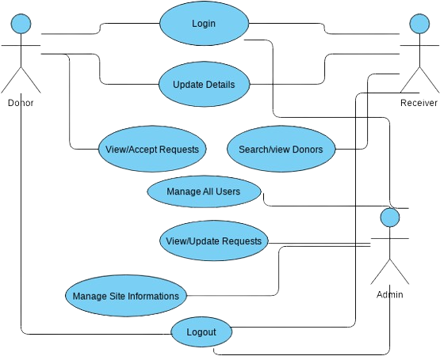
Use Cases

Slide 7
functional REQUIREMENTS
SHOULD allow register Patient/Donor as a user.
SHOULD allow Login for User/Admin.
SHOULD provide enable profile management for Patient/Donor.
SHOULD allow users and admin to accept/Deny the response.
SHOULD provide Live chat assistance for users
SHOULD provide FAQS

Slide 8
functional REQUIREMENTS
SHOULD Schedule the appointment.
SHOULD provide Dashboard for admins to manage the donation relationship.
SHOULD allow admin side customer support/chat functionality.
SHALL NOT share user personal information with third parties without user consent.
SHALL NOT store sensitive medical information beyond basic requirements.

Slide 9
Non-functional REQUIREMENTS
Performance
Scalability
Security
Reliability and availability
User Interaction
Interoperability
Backup and recovery

Slide 10
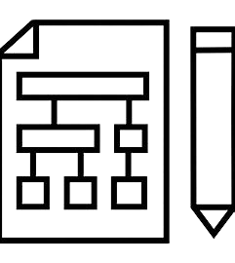
Architecture
Start
Main Page
NO
YES
Existing User
Register
Login
DONOR
Donor/Patient
PATIENT
View/Manage donation requests
Search for a Donor

Slide 11





Technologies & PLATFORMs used

Slide 12
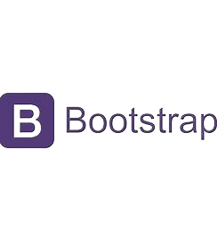


frameworks & LIBRARIES used
Axios
bcryptjs
cookie-parser
Cors
dotenv
Jsonwebtoken
Mongoose
Nodemon

Slide 13
Hosting strategy and requirements
We have configured the application locally with local configurations.
We are planning to host the application on render which is one of the unified cloud to build and run all your apps and websites providing only the limited storage for free.

Slide 14

DATAMANAGEMENT PLAN
Donor: DonorID (unique identifier)
Patient: PatientID (unique identifier)
Admin: AdminID (unique identifier)
Blood Bank: BloodBankID (unique identifier)
Request: RequestID (unique identifier)
CAN BE REFERRED AT –
https://lucid.app/lucidchart/e813eb76-2574-49b4-be56-7c144e284ecf/edit?viewport_loc=1221%2C-1100%2C1865%2C1141%2C0_0&invitationId=inv_3937bad6-c171-4b53-8251-1d8f88bdb83f

Slide 15
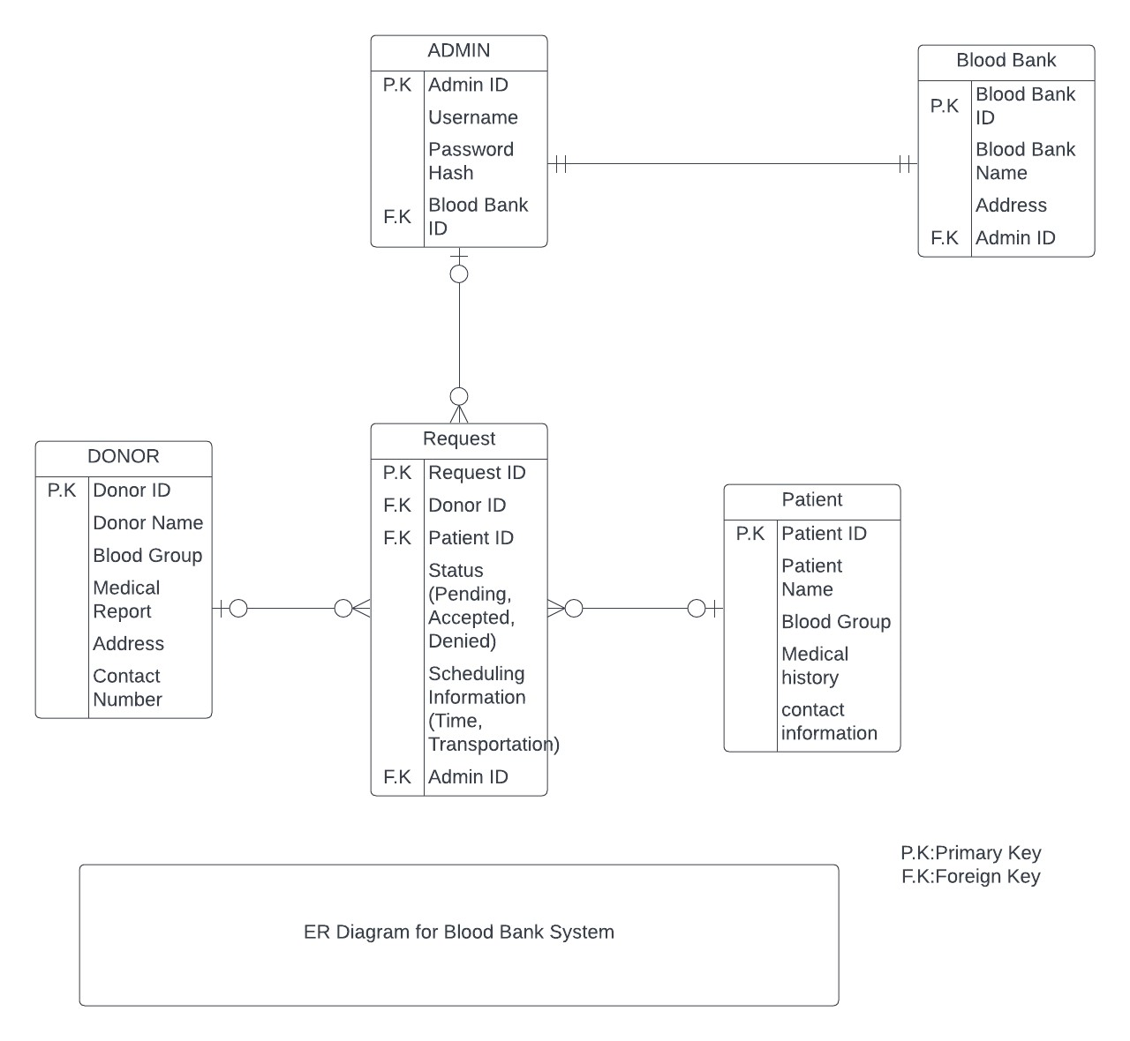
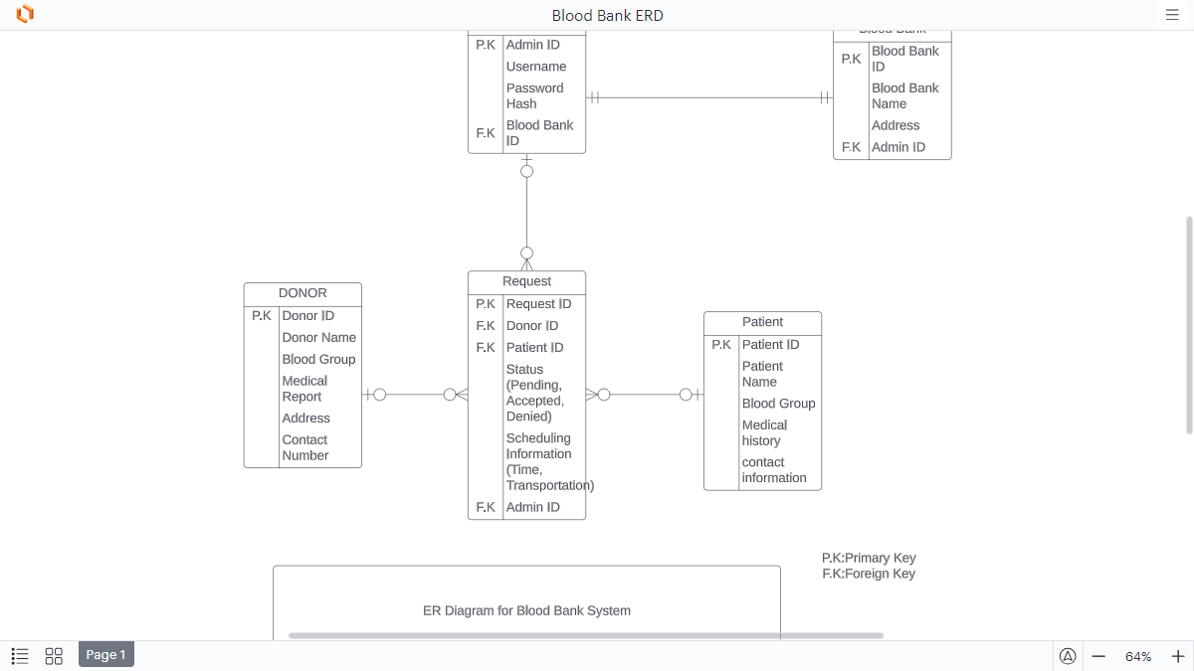
DATAMANAGEMENT PLAN - (Cont’d)

Slide 16

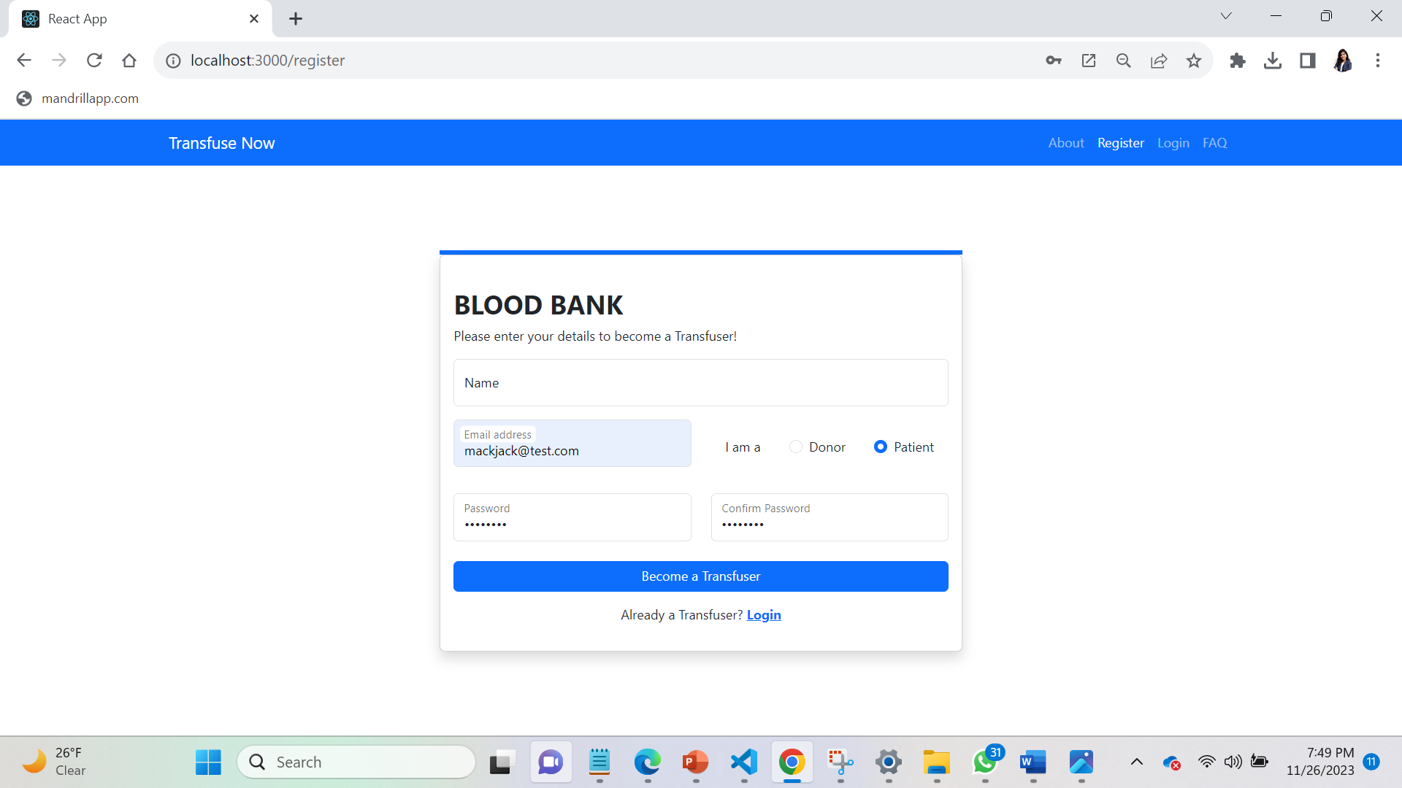
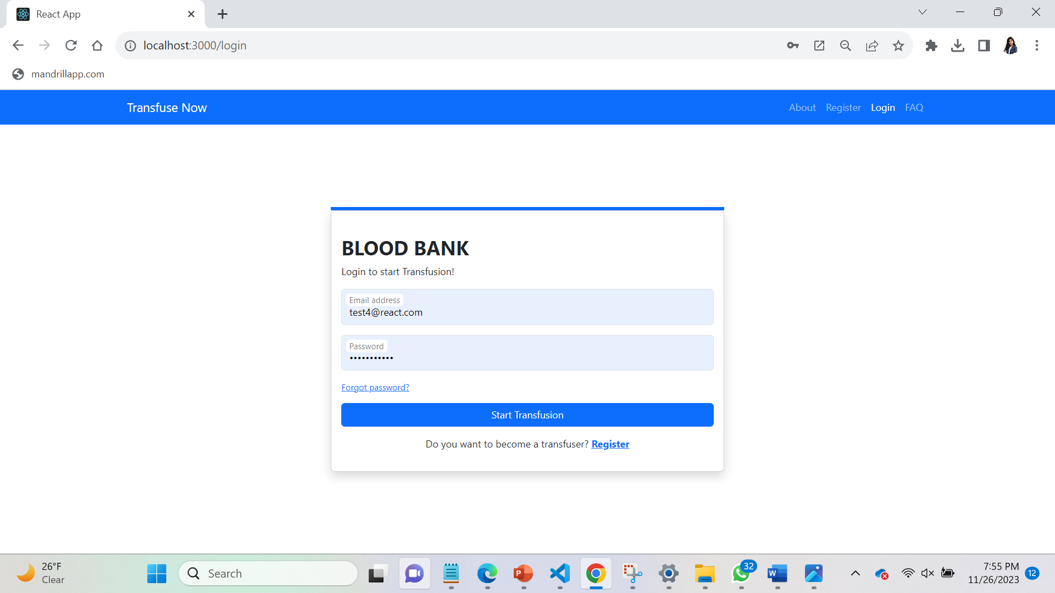
PROTOTYPES DEMO – GUI MOCKUPS

Slide 17
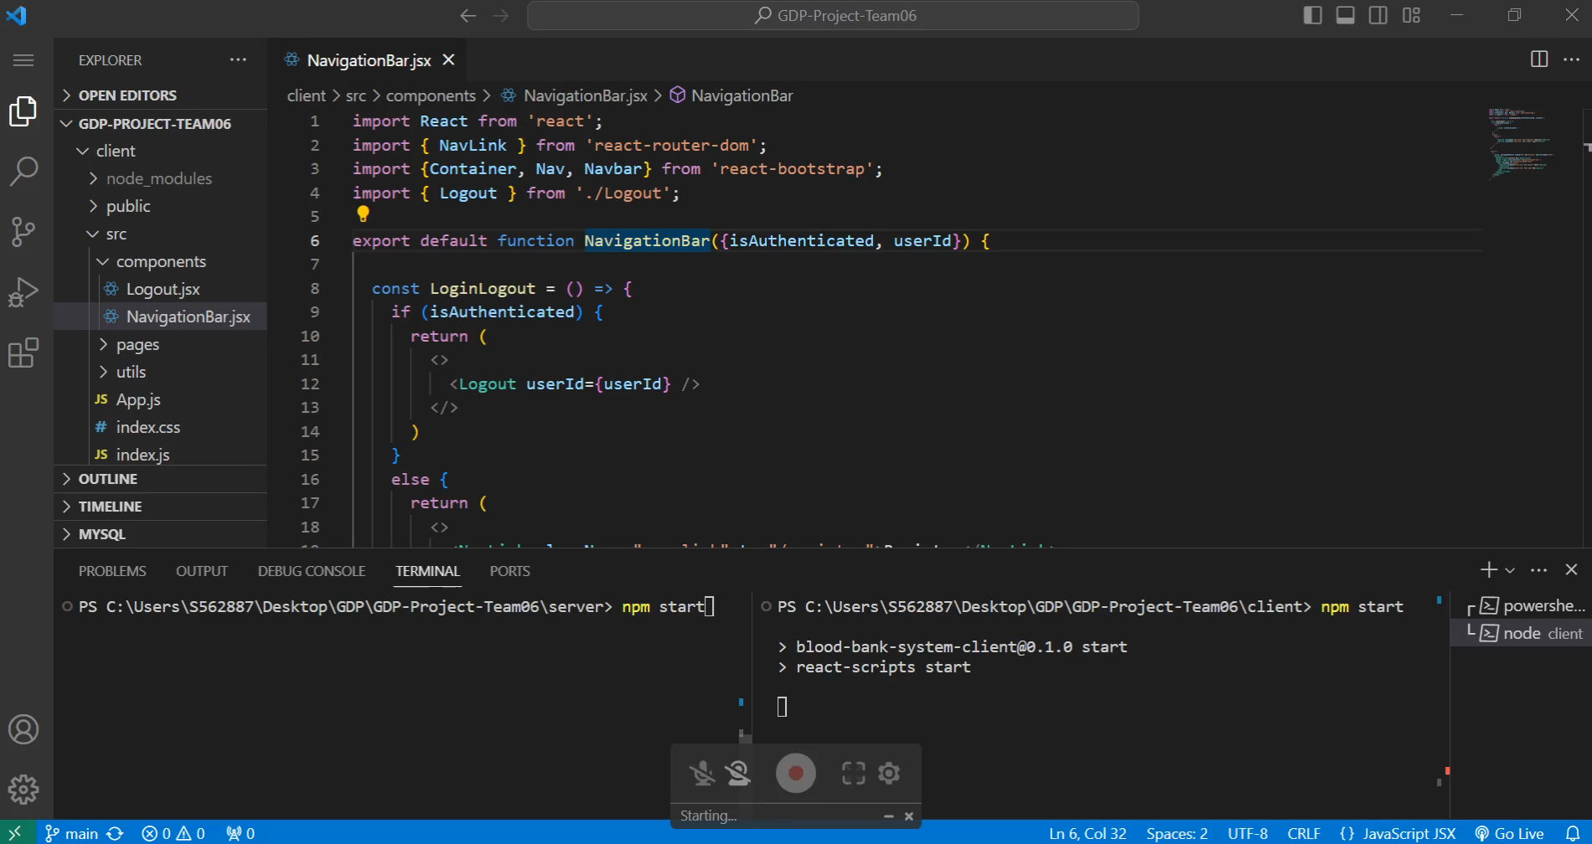
PROTOTYPES DEMO

Slide 18

ACCOMPLISHMENTS
GUI and Web Interface Implementation for REGISTER/LOGIN: An interface has been implemented to support user registration and login.
Data base creation using MongoDB: Created a database dedicated to the application to store the user details. This would support us to store the user credentials with password encrypted to authorize the users.
User profile creation: Successfully worked towards the user profile creation once they are registered

Slide 19

SPRING’24 PLAN
In GDP-2, we will be working on the below
Search functionality for the patients will be done to search for a donor.
Request management will be implemented to the donors to manage requests.
FAQs and live chat feature will be added to the application to support user interaction with the application.
Admin functionality will be implemented for the management of blood inventory, user requests.
A great home page will be created and integrated with the existing functionalities for better user experience.

Slide 20


